Slide 1

TMDB Movie Data Analysis
Harsh Kumar Gupta
Mentored by : Sir Ashish Rajput

Slide 2
CONTENTS
INTRODUCTION
BUSINESS OBJECTIVES
CONCLUSION
PREPROCESSING
ANALYSIS

Slide 3

INTRO & OBJECTIVE
Helping a movie company to analyse the type of movies and genres that perform well in cinema.
Notes:
Music production
Good actor but less popularity
High budget but low audience

Slide 4

BUSINESS OBJECTIVE
How are popularities of movies related with the movie budgets?
Identify and display the names of all production companies along with the number of times they appear in the dataset.
Display the names of the top 25 production companies based on the number of movies they have produced in descending order of the number of movies produced.
Sort the data in descending order based on revenue and filter the top 500 movies and perform Outlier analysis
Identify and display the names of the movies along with their run times for those movies that have above average runtime
Load the movie dataset in the Python notebook. Display the numbers of rows and columns in the dataset. Display the titles and genres of the first 50 movies from the dataset.
Identify the columns that have null values and perform the null value treatment.
Display the movie categories that have a budget greater than $220,000.
Display the movie categories where the revenue is greater than $961,000,000.
Remove the rows with value 0 from both the budget and revenue columns.
List the top 10 movies with the highest revenues and the top 10 movies with the least budget.

Slide 5

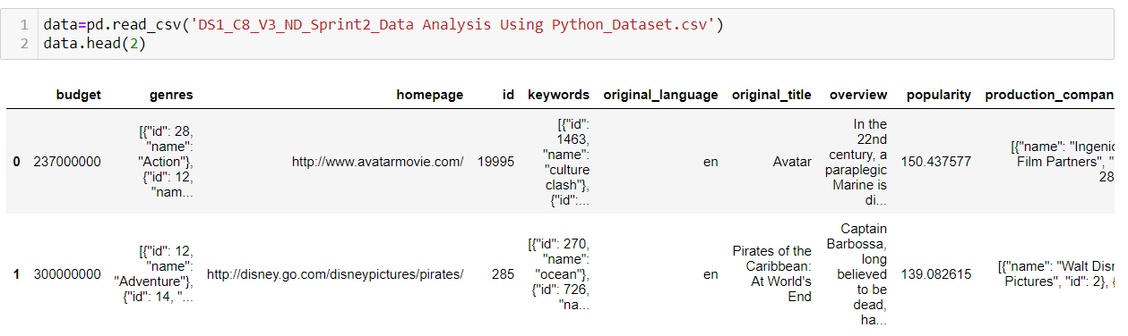

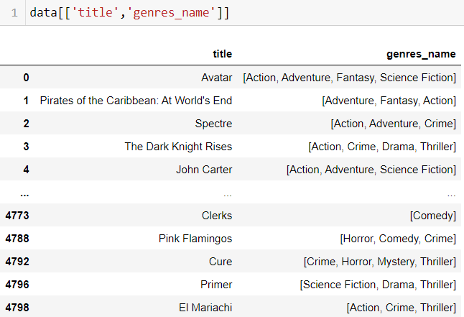
Data Preprocessing

Slide 6

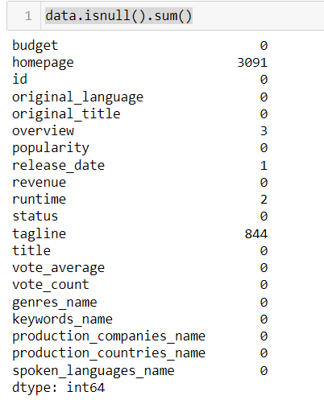


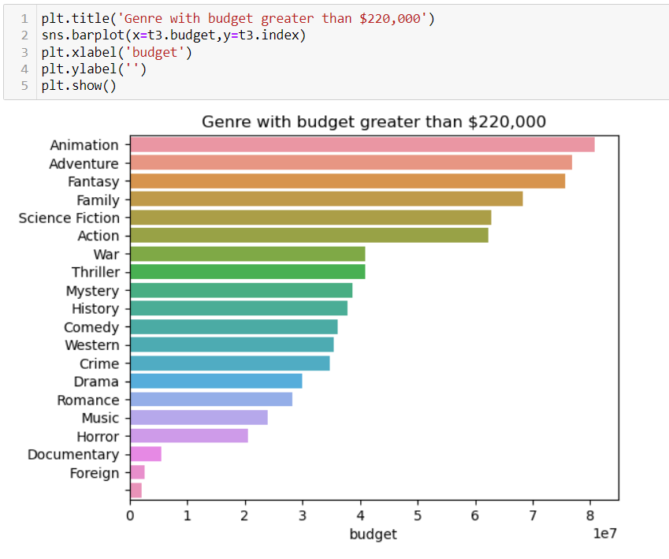

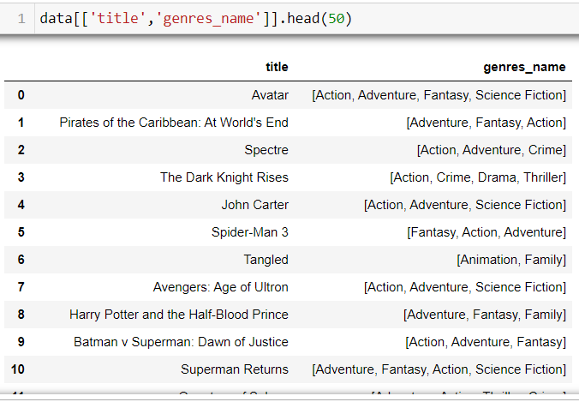
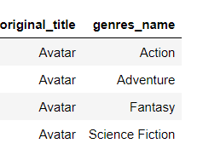
Load the movie dataset in the Python notebook. Display the numbers of rows and columns in the dataset. Display the titles and genres of the first 50 movies from the dataset.
Identify the columns that have null values and perform the null value treatment.
Display the movie categories that have a budget greater than $220,000.
2
3
1
Identify the columns that have null values and perform the null value treatment.
Identify the columns that have null values and perform the null value treatment.
BEFORE
AFTER FLATEN
Null values in realease_date was dropped
Null value in runtime was filled by the average runtime
There are a total of 4803 records of movies and 20 columns
There are total of 20 genre that have budget greater than $220,000
Animation genre has the highest budget

Slide 7
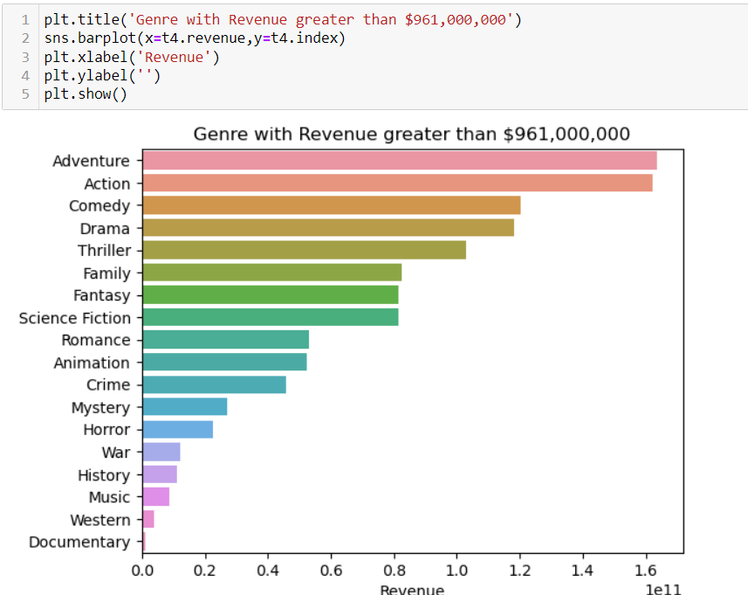

Display the movie categories where the revenue is greater than $961,000,000.
Remove the rows with value 0 from both the budget and revenue columns.
4
5
Adventure Genre has generated the highest revenue
Documentary genre has generated the least revenue
The revenue 0 and budget 0 movies were dropped

Slide 8
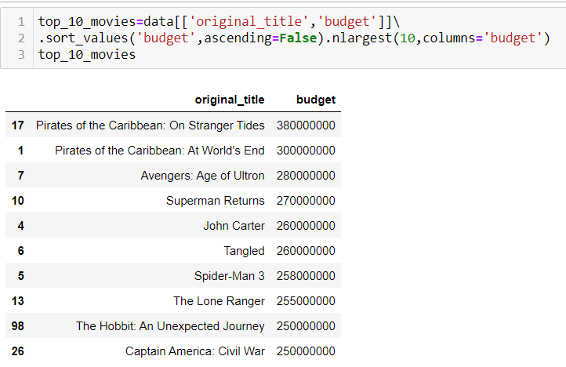
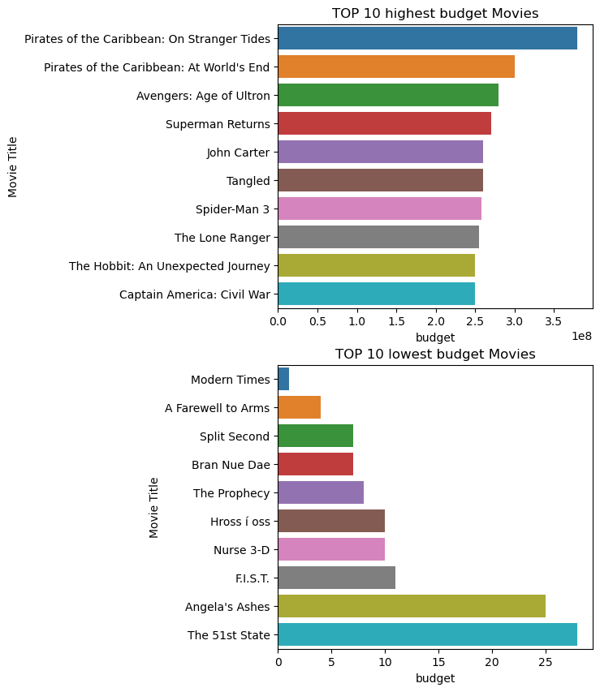
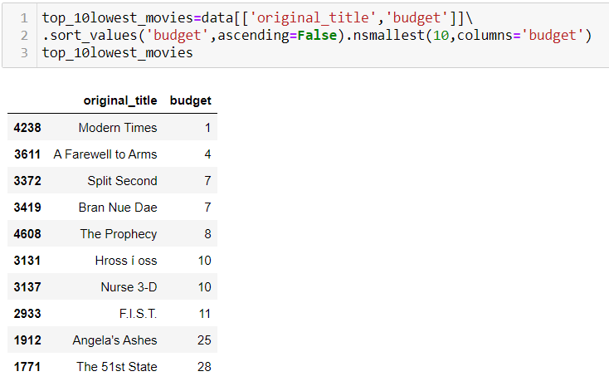
Identify the columns that have null values and perform the null value treatment.
List the top 10 movies with the highest revenues and the top 10 movies with the least budget.
6
Highest revenue
Pirates of the Caribbean
is the movie with the highest budget
Least revenue
Modern Times
is the movie with the lowest budget

Slide 9
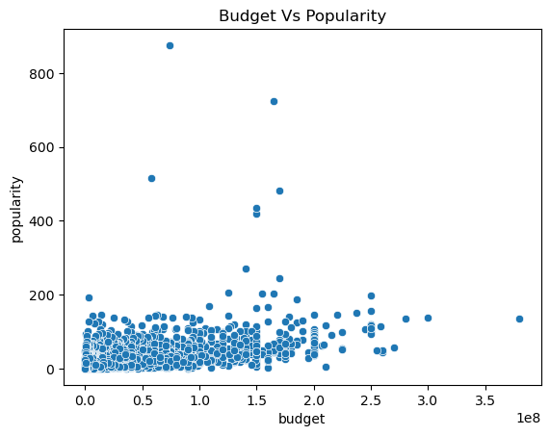
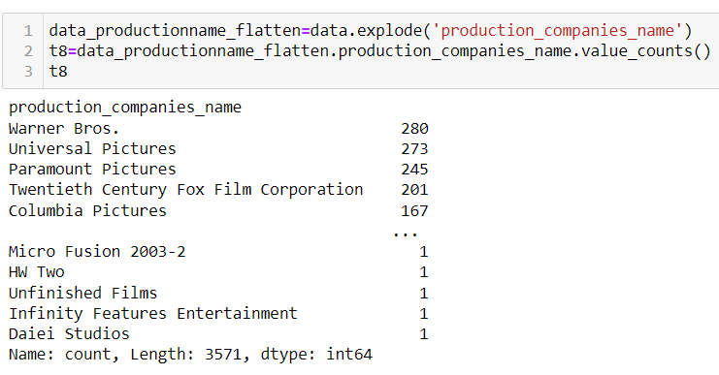
How are popularities of movies related with the movie budgets?
Display the names of all production companies along with the number of times they appear in the dataset.
7
8
There is no correlation between the budget and popularity
Most of the movies are made in the budget between $ 0 to $ 20000000
There are total 3571 movie production companies
Warner Bros. has produced 280 movies which is the highest in the dataset

Slide 10
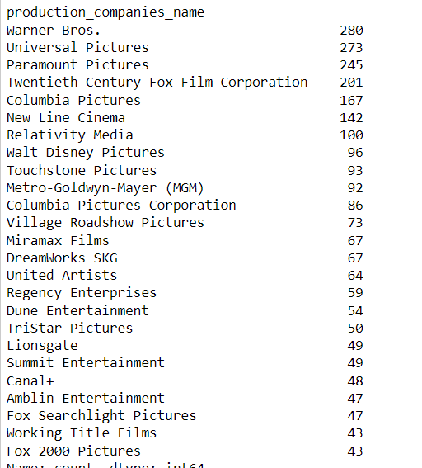
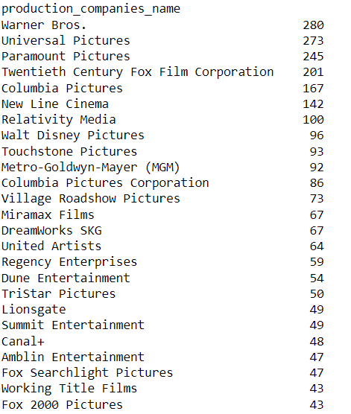
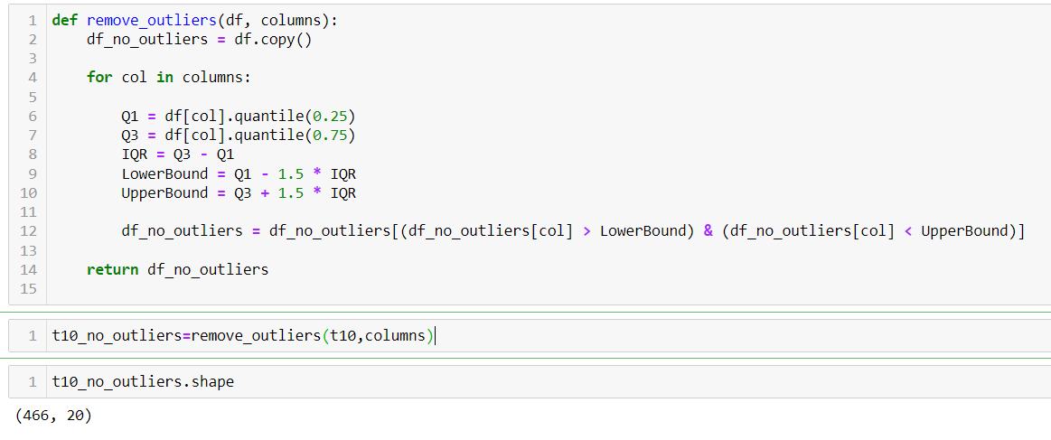
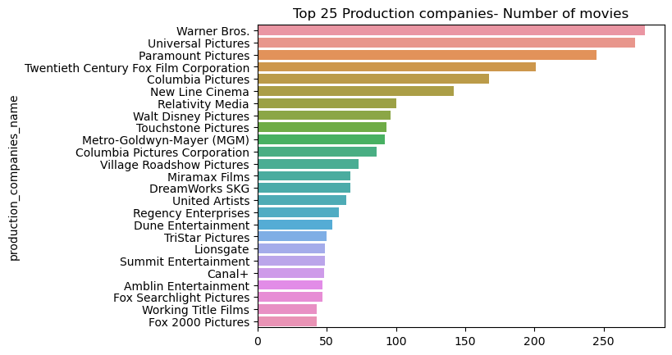

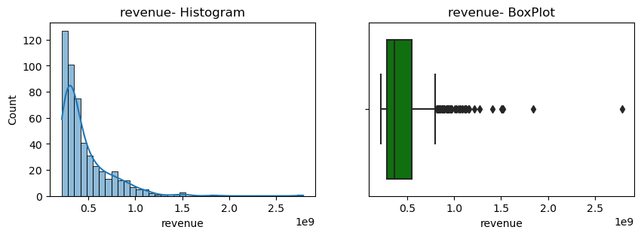

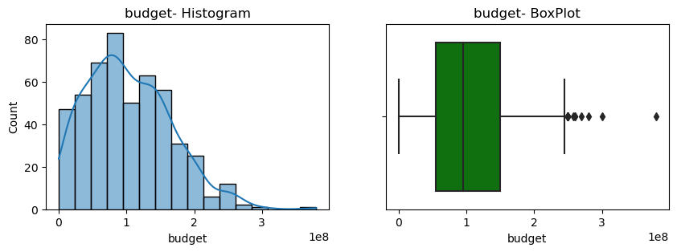
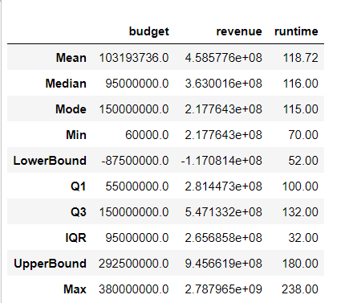
Display the names of the top 25 production companies based on the number of movies
Sort the data in descending order based on revenue and filter the top 500 movies. (Perform outlier analysis)
9
10
Warner Bros has produced most number of movies
All the outliers were removed and at the end we were left with 466 movies

Slide 11
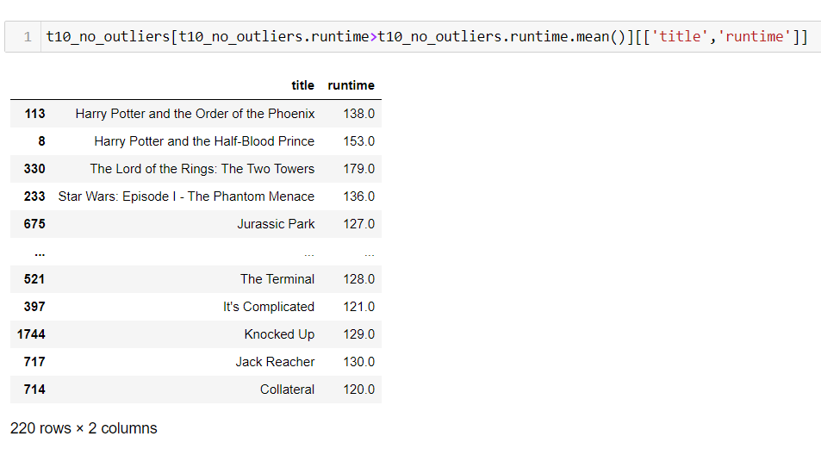
Display the movie categories where the revenue is greater than $961,000,000.
11
There are220 movies whose runtime is greater than the average average runtime

Slide 12

CONCLUSION
Animation movies will generate most Revenue as it is more loved by audience
Warner Bros. is the best performing company
Movies produced by Warner Bros. have the best runtime
The category Documentary is the lowest revenue generating category
Budget doesn’t not affect the revenue : meaning that if popular genre is selected the movie will generate high revenue

Slide 13

THANK YOU

